Slide 1
Robotics Group Project
Jack Galvin - K1502525 (1507192)
Jamie Slome - K1502586 (1515864)
Zehra Punjwani - K1502450 (1431800)

Slide 3
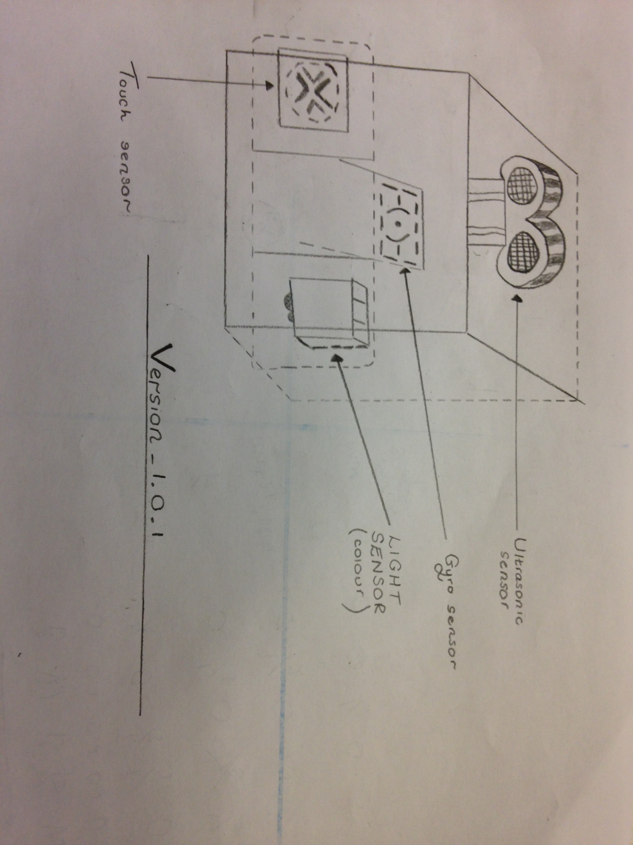
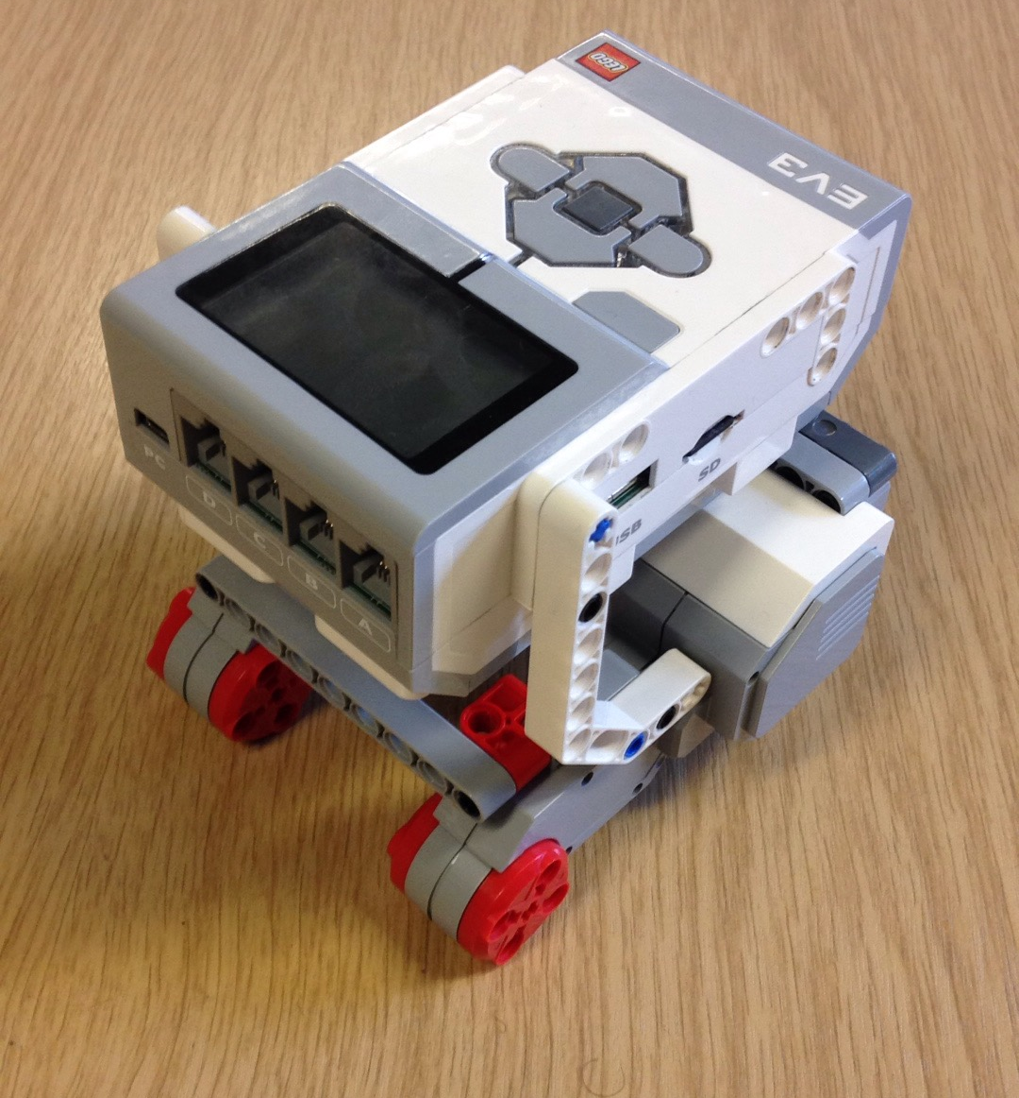
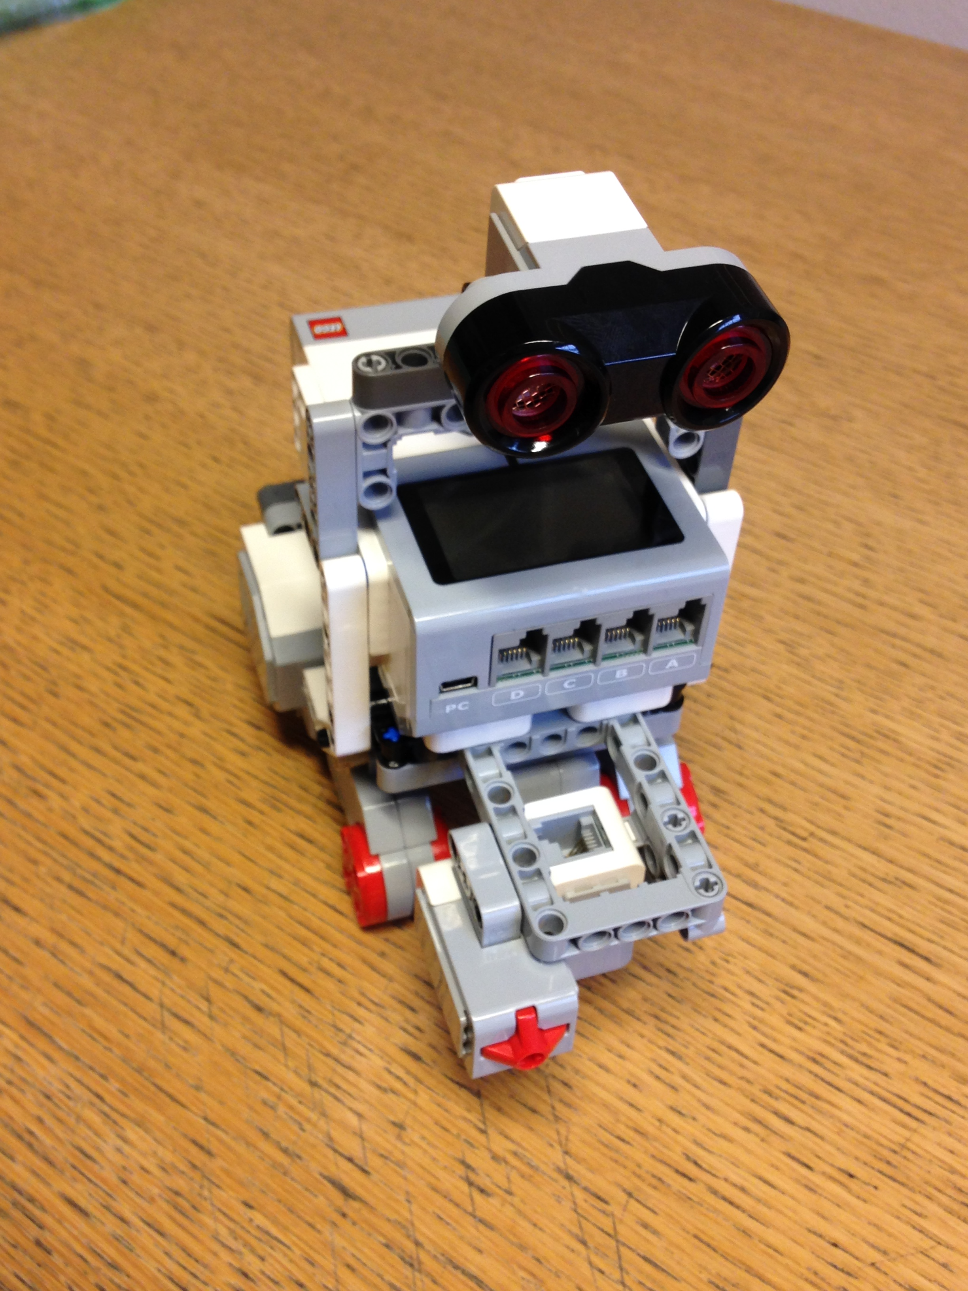
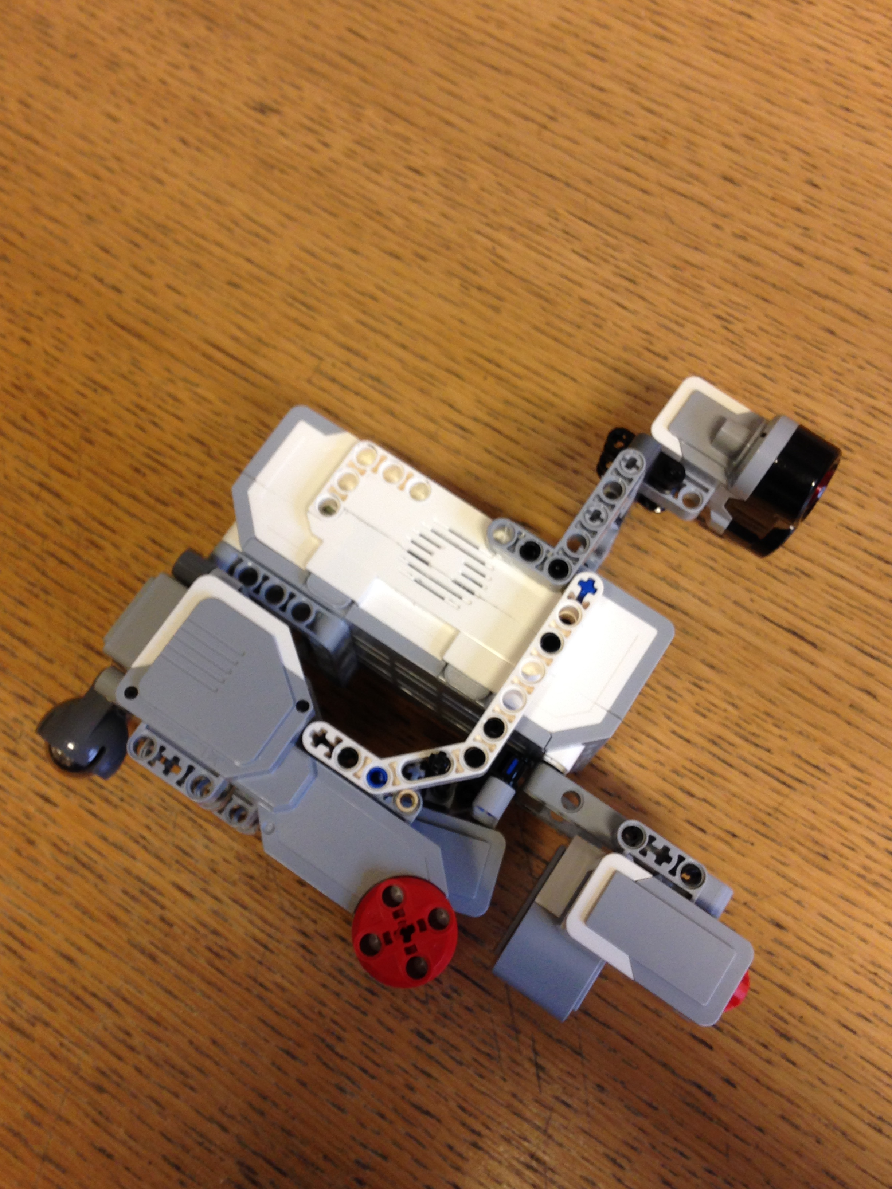
HARDWARE DESIGN

Slide 4
Evaluation Results

Slide 5
Single Function Testing Results

Slide 6
Integrated System Testing Results

Slide 7
SOFTWARE DESIGN

Slide 8
Implementation Details

Slide 9
Evaluation Results

Slide 10
Single Function Testing Results

Slide 11
Integrated System Testing Results

Slide 12
TEAM MANAGEMENT

Slide 13
Project Milestones

Slide 14
Main Tasks, Time Lines and Individual Contribution

Slide 15
CONCLUSION

Slide 16
Comments and Future Improvements

